Slide 1
Official 2015 Bankruptcy Forms in CM/ECF Overview for Attorney
December 1, 2015

Slide 2
Dec. 1, 2015 Bankruptcy Forms
Implementing 2015 Forms in CM/ECF
New Official Bankruptcy Forms will become effective December 1, 2015.
The case opening process for voluntary and involuntary bankruptcy cases remains the same.
CM/ECF bankruptcy case opening screens will be modified to include some changes to the new 2015 forms (petition and schedules).
Notes:
The Bankruptcy Forms Modernization Project is an initiative that will require filers to use new official bankruptcy forms as of December 1, 2015. The goal in this forms modernization project is to simplify the language to make it more understandable to both the legal community and debtors filing pro se. The petitions, all schedules and other official forms will be renumbered.

Slide 3
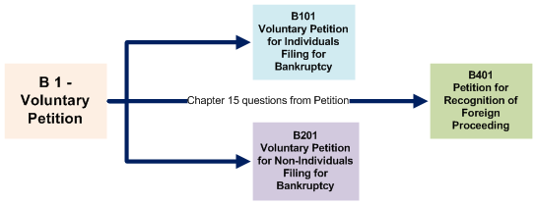
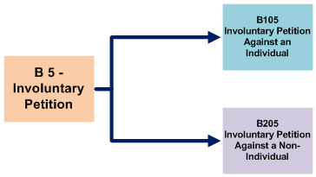
Dec. 1, 2015 Bankruptcy Forms
Case Opening Forms
Notes:
The biggest impact will be with the case opening petition forms. The current Voluntary and Involuntary petitions will be broken into 5 separate forms. Most of the form changes involve separating the forms by the type of debtor. So there are now separate forms for individual debtors and non-individual debtors. However, there will be one docketing event in most courts for a voluntary or involuntary petition.

Slide 4
Dec. 1, 2015 Bankruptcy Forms
Case Opening Forms
Notes:
The B1 Voluntary Petition form will now be separated into the B101 Voluntary Petition for Individuals, the B201 Voluntary Petition for Non-Individuals and there is now a separate B401 petition for a Chapter 15 Petition. There has been increased interest in specific kinds of business filings such as financial services, health care providers, churches, real estate brokers, etc., by Congress, the Judiciary, businesses, researchers and other federal agencies. The new forms and screen selections will now be able to capture more categories of debtors’ business descriptions for reporting.

Slide 5
Dec. 1, 2015 Bankruptcy Forms
Case Opening Forms
Notes:
The B5 Involuntary Petition will also be separated by debtor type. There will be an Involuntary Petition against an Individual and an Involuntary Petition against a non-Individual. However, most courts will still use one docketing event for opening a voluntary case and one docketing event for opening an involuntary case.

Slide 6
Dec. 1, 2015 Bankruptcy Forms
Case Opening
Case Opening Forms
Form B101 Voluntary Petition for Individual Debtors
This form is now 8 pages
Includes credit counseling information, Exhibit D now included as part of the petition.
Includes chapter 7 and 11 individual business data
Language and instructions are now simpler on all forms
There are comprehensive instructions accompanying all the new forms.
Notes:
The new petitions provide new options that will be collected in CM/ECF for statistical reporting. Some of the changes include:
Form is now 8 pages in length
Credit counseling information from Exhibit D now included as part of the petition
Chapter 7 and 11 individual business data
Simpler language and instructions on all forms
Comprehensive instructions that accompany all new forms

Slide 7
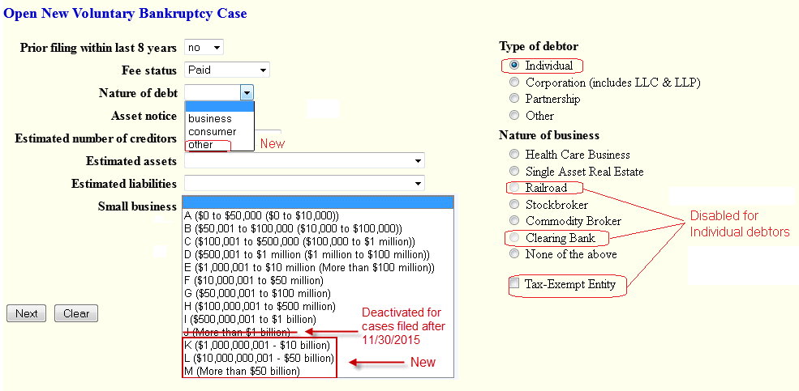
Dec. 1, 2015 Bankruptcy Forms
Form 101 - Voluntary Petition for Individuals
Nature of Debt:
Business
Consumer
Other New
Notes:
Here are some of the CM/ECF screens that have changed to conform to the new rules and forms. The B101 Voluntary Petition for individuals now asks if debts are primarily Consumer, Business or Other in Part 6 of the new form. And Individuals now have the option to select a Nature of Business to describe their Sole Proprietorship.

Slide 8
Dec. 1, 2015 Bankruptcy Forms
Form 101 - Voluntary Petition for Individuals
Nature of Business
Railroad
Clearing Bank
Disabled for Individual debtors.
Notes:
Since Form 101 is only for Individuals, Railroad and Clearing Bank will be greyed out and disabled as options for Nature of Business if the debtor is an individual as Form 101. The Tax Exempt Entity checkbox will no longer appear for Nature of Business if the debtor is an individual.

Slide 9
Dec. 1, 2015 Bankruptcy Forms
Form 101 - Voluntary Petition for Individuals
Est Assets and Est Liabilities
Code J is deactivated >$1 billion
New codes K, L, M >$1-50 billion
Notes:
Estimated Assets and Estimated Liabilities Code J (More than $1 Billion) has been expanded to 3 more levels ranging from $1,000,000,001 to More than $50 billion for both individual and non-individual debtors.

Slide 10
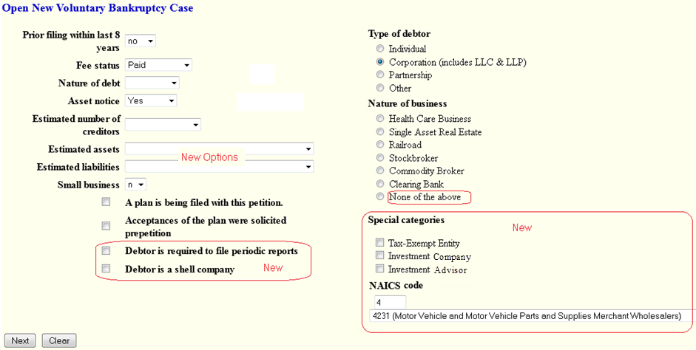
Dec. 1, 2015 Bankruptcy Forms
Form 201 Voluntary Petition for Non-Individuals
New Nature of Business codes:
Investment Company
Investment Advisor
Other changed to None of the Above
Notes:
This is the new statistical screen for a Chapter 11 non-individual case. In an effort to identify more specific business types, two new Natures of Business options for Non-Individual filers have been added, Investment Company and Investment Advisor. The value of Other has been changed to None of the Above.

Slide 11
Dec. 1, 2015 Bankruptcy Forms
Form 201 Voluntary Petition for Non-Individuals
New Chapter 11 Fields
Debtor is Required to file periodic reports
Debtor is a shell company
New NAICS business codes:
Notes:
Additionally a new statistical NAICS business code has been added. The North American Industry Classification System (NAICS) is the standard used by Federal statistical agencies in classifying business types and will allow the AO to respond better to Congressional, Judiciary, and public inquiries on types of bankruptcy filings. The first 4 digits of the NAICS code will be collected for reporting.

Slide 12
Dec. 1, 2015 Bankruptcy Forms
Form B401 Chapter 15 Case Opening
Petition for Recognition of Foreign Proceeding
Foreign Main Proceeding
Foreign Nonmain Proceeding
Foreign Main Proceeding, or in the alternative, foreign Nonmain Proceeding
Notes:
There is a new Nature of Foreign Proceeding selection when opening a chapter 15 case. It is designed as an alternative for the filer who is not sure if it’s a main or non-main proceeding.

Slide 13
Dec. 1, 2015 Bankruptcy Forms
Form B401 Chapter 15 Case Opening
Petition for Recognition of Foreign Proceeding
Limited statistical data collected for Chapter 15.
Only Fee Status and Type of Debtor will be captured from this Chapter 15 statistical case opening screen.
Notes:
There is no longer any statistical reporting from this screen for Chapter 15 case opening except for Fee status, which will always be paid and Type of Debtor.

Slide 14
Dec. 1, 2015 Bankruptcy Forms
Chapter 11 Case Opening
EOUST Statistical screen
Limited statistical data collected for Chapter 15.
None of the Above
This field is not required, but an error message will display if checked for any chapter other than Chapter 11.
Notes:
In an attempt to qualify chapter 11 cases, this field on this statistical screen will produce an error message if it is checked for a case other than a chapter 11.

Slide 15
Dec. 1, 2015 Bankruptcy Forms
New form numbers and form names for schedules
Schedules A and B combined into Schedule A/B.
Schedules E and F combined into Schedule E/F.
Separate A/B Forms for Individual and Non-Individual debtors.
Separate E/F Forms for Individual and Non-Individual debtors.
Notes:
Besides the new format and content on the schedules, there are new form numbers and form names.
Schedules A and B are combined into Schedule A/B. (Forms B106A/B and B206A/B.)
Schedules E and F are combined into Schedule E/F. (Forms B106E/F and B206E/F.)

Slide 16
Dec. 1, 2015 Bankruptcy Forms
Schedules and Summary of Schedules
New Schedules have separate Individual
and Non-Individual forms and new form numbers.
Individual Non-Individual
B106A/B B206A/B
B106D B206D
B106E/F B206E/F
B106G B206G
B106H B206H
Notes:
Just like the Voluntary Petitions have been separated by Individual and Non-Individual debtor types, the schedules in this list have separate forms for Individual and Non-Individual debtor types. The remaining schedules are only required for Individual debtors. Depending upon the court, there may be separate docketing events for Individual and Non-Individual combined schedules. Or your court may have combined the form into one docketing event where the filer will signify if it represents an individual or non-individual debtor’s case.

Slide 17
Dec. 1, 2015 Bankruptcy Forms
Schedules and Summary of Schedules
Although the forms are combined, there are still separate fields for:
Real estate/property (Formerly Schedule A)
Personal property (Formerly Schedule B)
Priority unsecured claims (Formerly Schedule E)
Non-priority unsecured claims (Formerly Schedule F)
Users will be prompted to enter separate amounts for each field when docketing Schedule A/B and Schedule E/F.
Notes:
Although the forms have been combined, separate amounts for real estate, personal property, priority unsecured claims and non-priority unsecured claims are still being collected. There will be separate prompts for each field when docketing Schedule A/B and Schedule E/F.

Slide 18
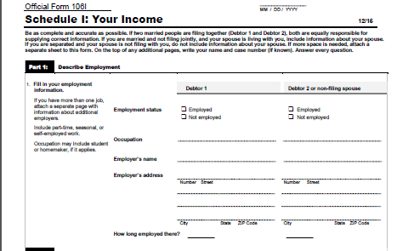
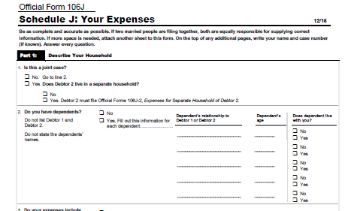
Dec. 1, 2015 Bankruptcy Forms
Schedules and Summary of Schedules
Schedules I and J only apply to individual debtors.
Individual
B106I - Income
B106J – Expenses
Notes:
Schedules I and J are not required for non-individual debtors.

Slide 19
Dec. 1, 2015 Bankruptcy Forms
Schedules and Summary of Schedules
New Form: B106J-2 Expenses for Separate Household of Debtor 2
The total of Debtors 1 and 2 expenses will be included on line 22b of Schedule J
Copy the result to line 22b of Schedule J to calculate the total expenses for Debtor 1 and Debtor 2.
Notes:
Expenses of Debtor 2 have been separated out into a new Form B106J-2. These expenses had been collected on a separate Schedule J that was noted by a check in this box for Debtor 2 who maintains a separate household. However, the total expenses for debtor 2 with a separate household will be added to debtor 1’s expenses for one total of expenses for both joint debtors.

Slide 20
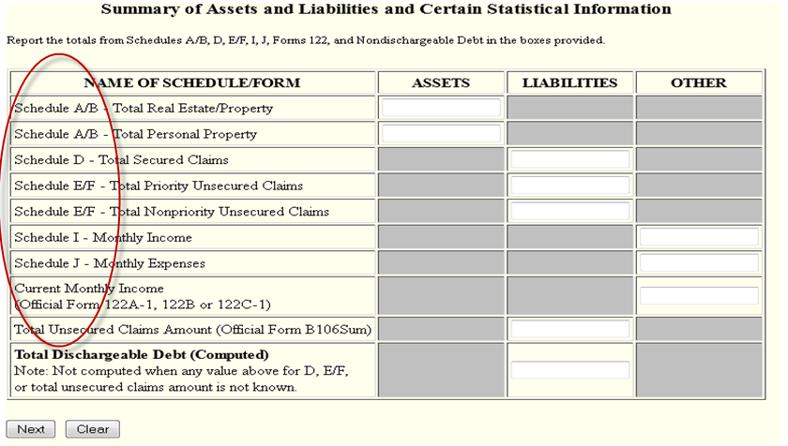
Dec. 1, 2015 Bankruptcy Forms
Summary of Your Assets and Liabilities and Certain Statistical Information (Form B106Sum)
Notes:
This CM/ECF screen will no longer be called the Summary of Schedules. It is now the Summary of Your Assets and Liabilities and Certain Statistical Information. You can see that schedules have been renamed, renumbered and A and B and E and F are now combined. There are still separate fields for real estate, personal property, priority unsecured claims and non-priority unsecured claims. Individual and Non-Individual debtors will not use the same forms and there are no Non-Individual forms for Schedules I and J. However, this screen will still be presented to non-individual filers to capture values from Schedules A/B, D, and E/F. Just like in CurrentGen, when these schedules have values in all of the Liabilities column, the Total Dischargeable Debt will be computed for both individuals and non-individuals.

Slide 21
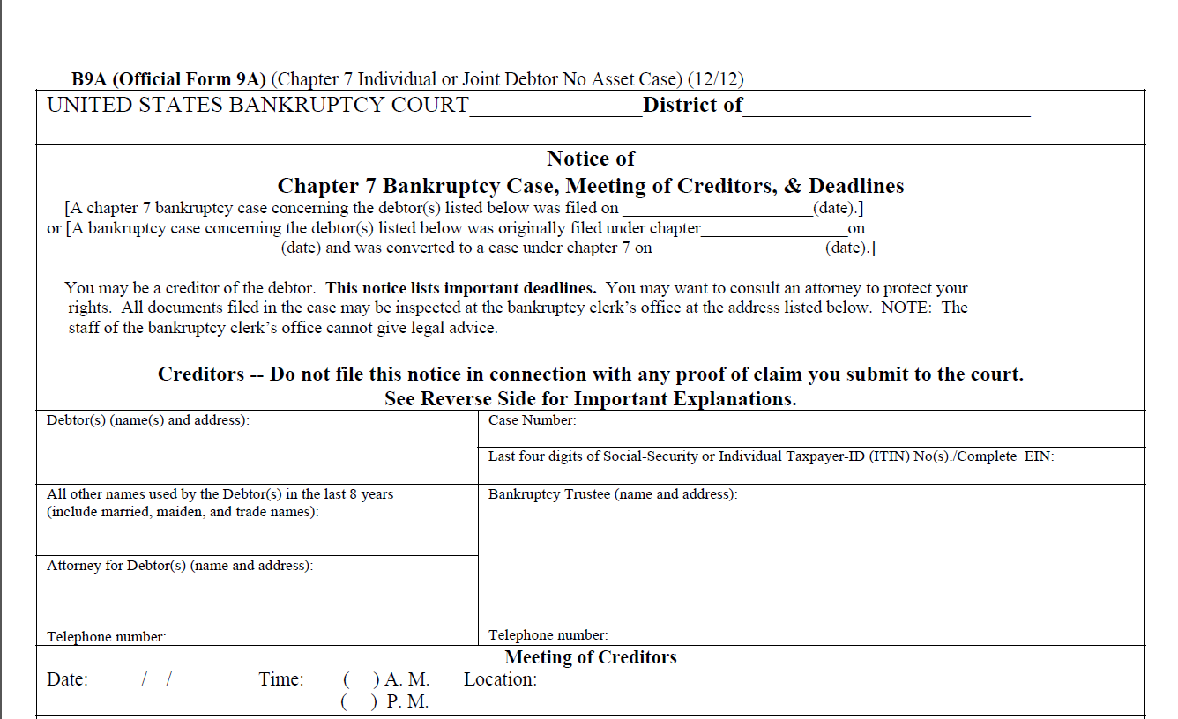
Dec. 1, 2015 Bankruptcy Forms
Meeting of Creditors Notices (Form B9A)
Prior to Dec. 1, 2015
Chapter 7 No Asset Case
Notes:
This is an example of the Meeting of Creditors Notice for Chapter 7 no asset cases (Form B9A) , being used prior to December 1, 2015. Note the form number, form title and formatting of this form when comparing to the new notice that will be used as of December 1, 2015. The revised version is shown on the next slide.

Slide 22
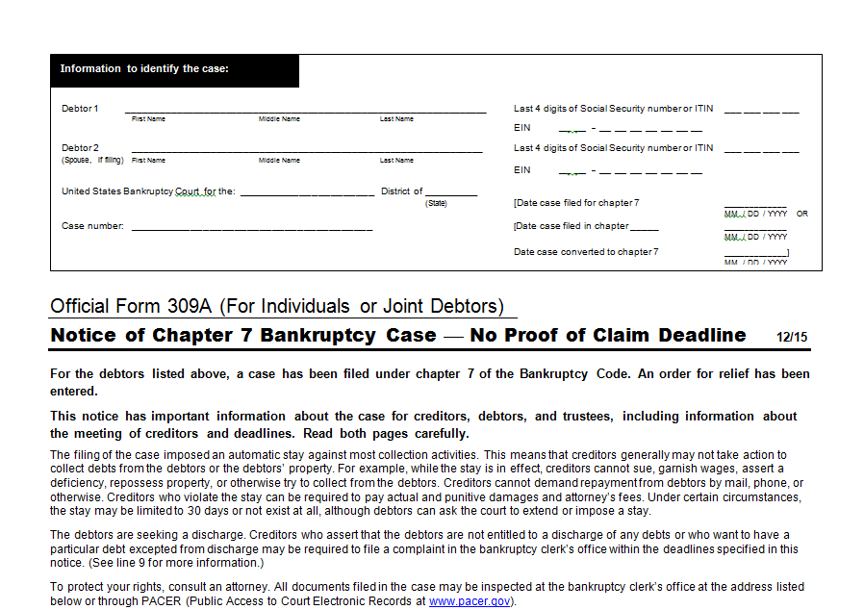
Dec. 1, 2015 Bankruptcy Forms
Revised Meeting of Creditors Notices (Form 309A)
Dec. 1, 2015
Chapter 7 No Asset Case
Notes:
This is the revised version of the Meeting of Creditors Notice for Chapter 7, no asset cases. The form number has changed to 309A, the form title has changed to “Notice of Chapter 7 Bankruptcy Case – No Proof of Claim Deadline, a header to identify the case is included at the top of page 1, and the language has been revised.

Slide 23
Dec. 1, 2015 Bankruptcy Forms
Additional Considerations of Impact of December 2015 Official Forms on Bankruptcy Filings
Your court will advise you regarding changes affecting:
Local rules to comply with new FRBP requirements
Court filing procedures
Contacting petition preparer software vendors prior to December 1
New and modified docketing events
New and modified noticing forms

Slide 24
Dec. 1, 2015 Bankruptcy Forms
Resources
Pending changes for 2015 Bankruptcy Forms on US Courts Web Site
http://www.uscourts.gov/rules-policies/pending-rules-amendments/pending-changes-bankruptcy-forms
Notes:
At this time the pending forms are posted on the uscourts.gov web site.

